Slide 1
Topic Modelling On News Articles
Aravinth A - 2022506035
Arjun N - 2022506060
Nagaraj BharathKumaran S - 2022506307

Slide 2
Introduction to Topic Modeling
Topic Modeling is an unsupervised machine learning technique used to automatically discover abstract topics in a collection of documents.
Helps in:
Text summarization
Content recommendation
Trend analysis
Document clustering

Slide 3
Dataset Overview
Columns
Article_id – Unique identifier for each article.
Headline – Title or main heading of the article.
Desc – Brief summary or teaser of the article.
Date – Publication date of the article.
Url – Web address where the article is published.
Articles – Full content/body of the article.
Article_type – Category or label indicating the type of article.
article_length – Word count or length of the article text.
Dataset Name : News_Articles_Indian_Express
Source : Kaggle

Slide 4
Preprocessing Steps
Objective: Clean and standardize text for modeling.
Convert text to lowercase
Remove URLs, HTML tags, and special characters
Tokenize text
Remove stopwords (common but non-informative words)
Remove documents with ≤ 5 words to improve signal-to-noise ratio
Save cleaned dataset for reuse

Slide 5
Vectorization Methods
CountVectorizer (LDA):
Creates a document-term matrix (DTM) using raw word counts
Suitable for probabilistic models like LDA
TfidfVectorizer (NMF):
Computes Term Frequency–Inverse Document Frequency (TF-IDF)
Captures importance of words across documents
L1-normalization ensures topic probabilities sum to 1

Slide 6
Latent Dirichlet Allocation (LDA)
Probabilistic graphical model
Assumes:
Each document is a mixture of topics
Each topic is a distribution over words
Uses Dirichlet distributions to model uncertainty
Input: Bag-of-words (count matrix)
Output: Topic-word & document-topic distributions

Slide 7
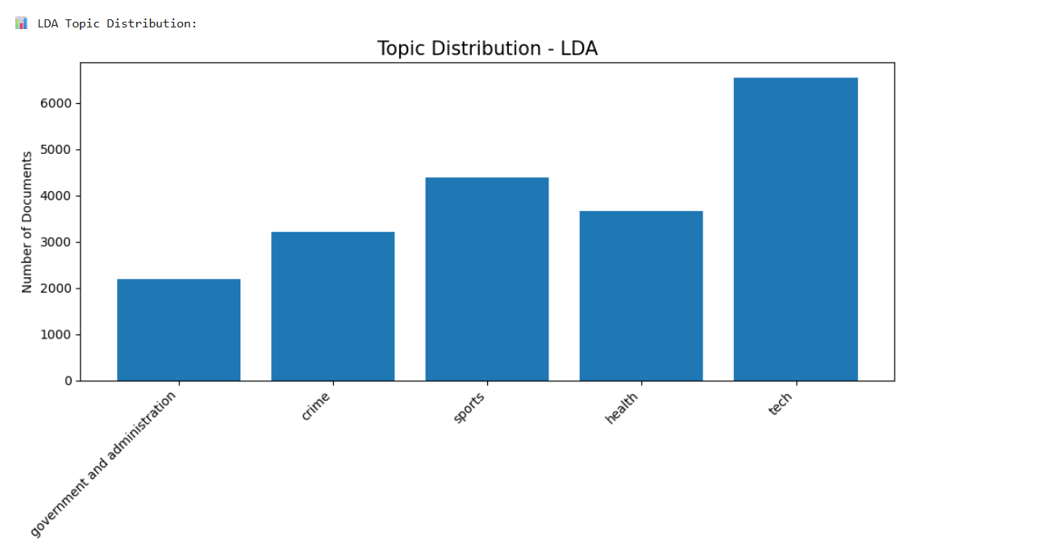
Output

Slide 8
Non-negative Matrix Factorization (NMF)
Linear algebraic approach
Factorizes matrix V ≈ W × H where:
V = TF-IDF matrix
W = Document-topic matrix
H = Topic-word matrix
All values are non-negative: improves interpretability
Works well with short and sparse text

Slide 9
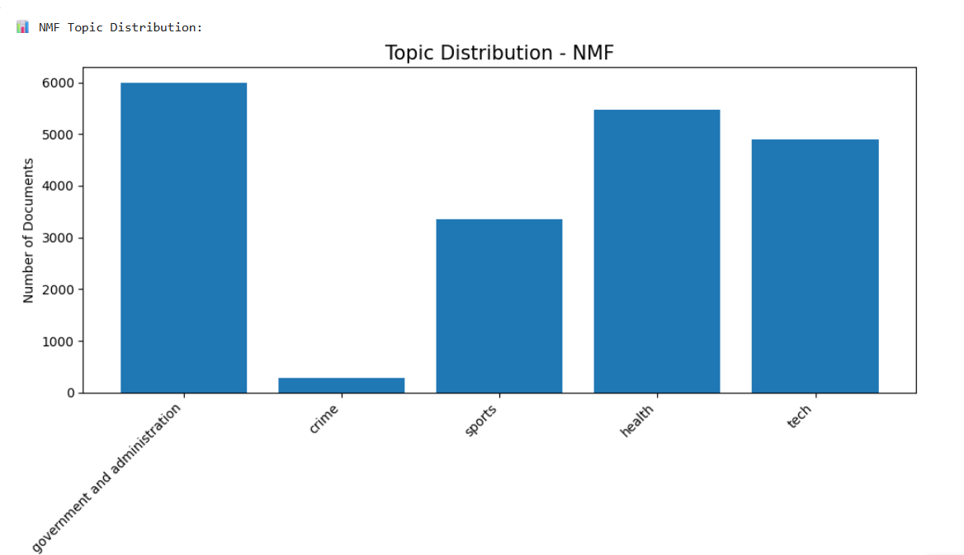
Output

Slide 10
BERT-based Topic Modeling Summary
Model Used: SentenceTransformer('all-MiniLM-L6-v2') – Fast and efficient BERT variant for sentence embeddings.
🔹 Steps Followed:
Embedding Generation – Created semantic vector representations for each article using BERT.
Dimensionality Reduction (UMAP) – Reduced high-dimensional embeddings for better clustering.
Clustering (HDBSCAN) – Automatically identified topic clusters with varying densities, excluding noise.
Topic Interpretation – Used TF-IDF within each cluster to extract top keywords and generate word clouds.
Topic Naming – Auto-generated descriptive names using the top 3 keywords per cluster.

Slide 11
Advantages of Bert Model
Context-aware embeddings outperform bag-of-words models.
No need to predefine the number of topics.
Better handles semantic similarity and short texts.

Slide 12
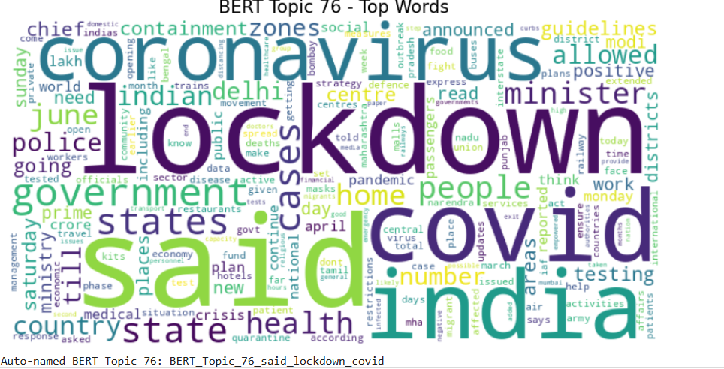
Output

Slide 13
Thank You

